Slide 1
Hardness test sample

Slide 2
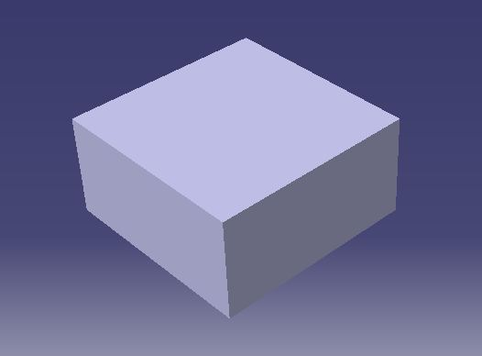
Cad model for hardness test

Slide 3
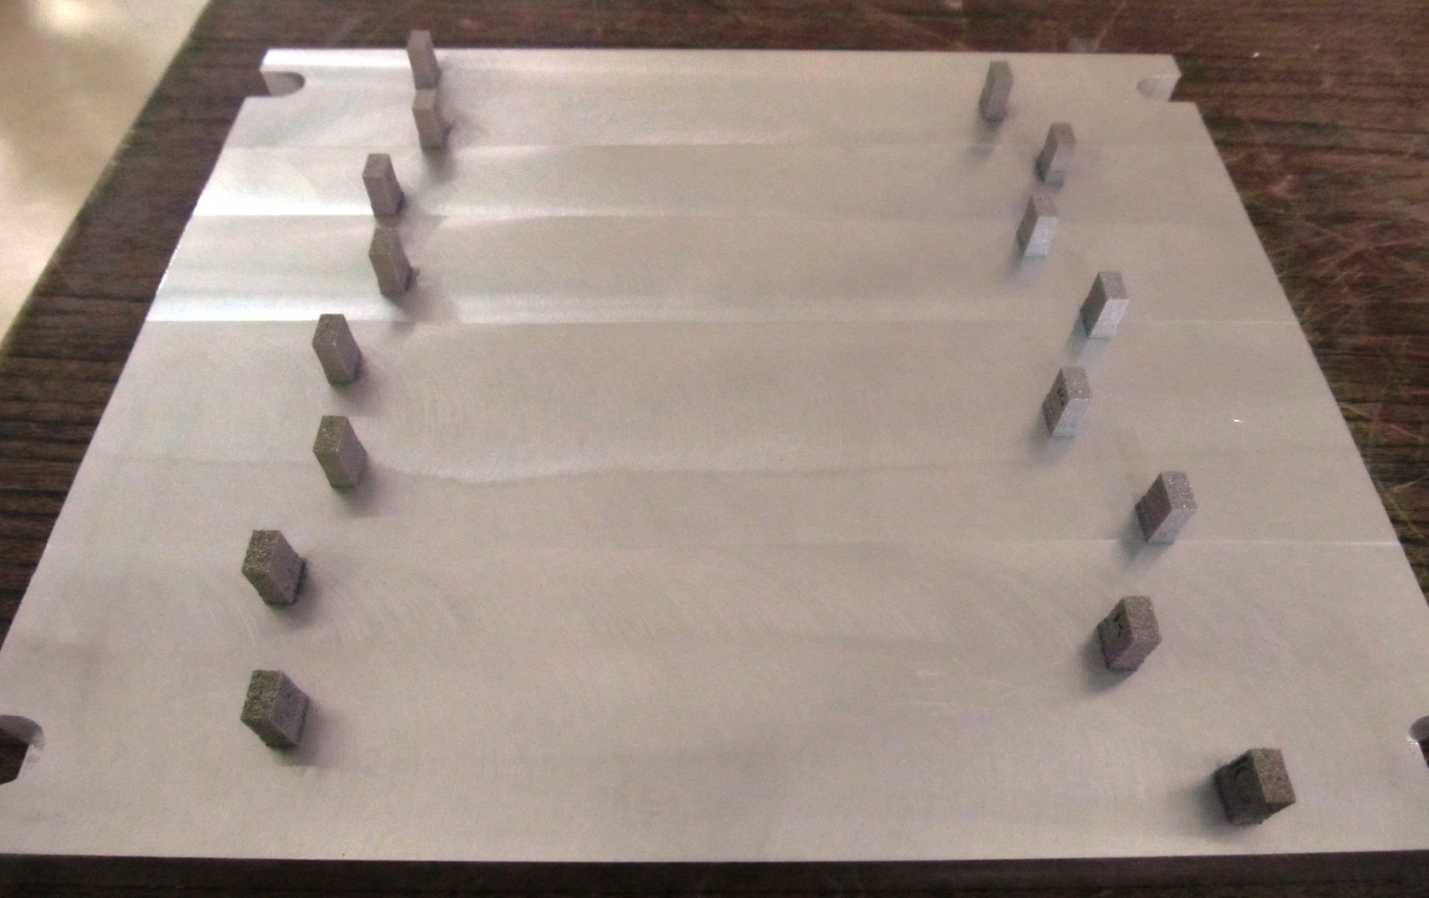
Test specimens for hardness test over platform

Slide 4
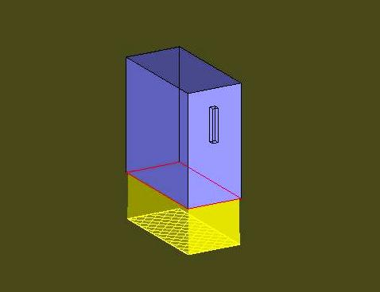
Cad model in magics software with support

